Slide 1
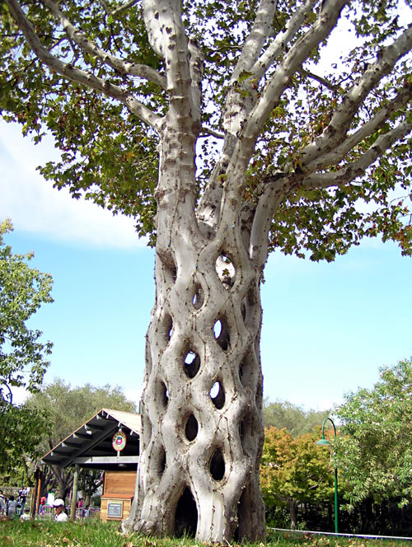
Grafting
Week #5

Slide 2
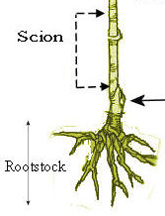
What is Grafting?
Grafting is a method of asexual propagation which requires joining parts of two plants together so they unite and grow as one.
The rootstock is the lower part of the combination rooted into the soil.
The scion is the part of the combination that will develop into the upper part of the plant.

Slide 3
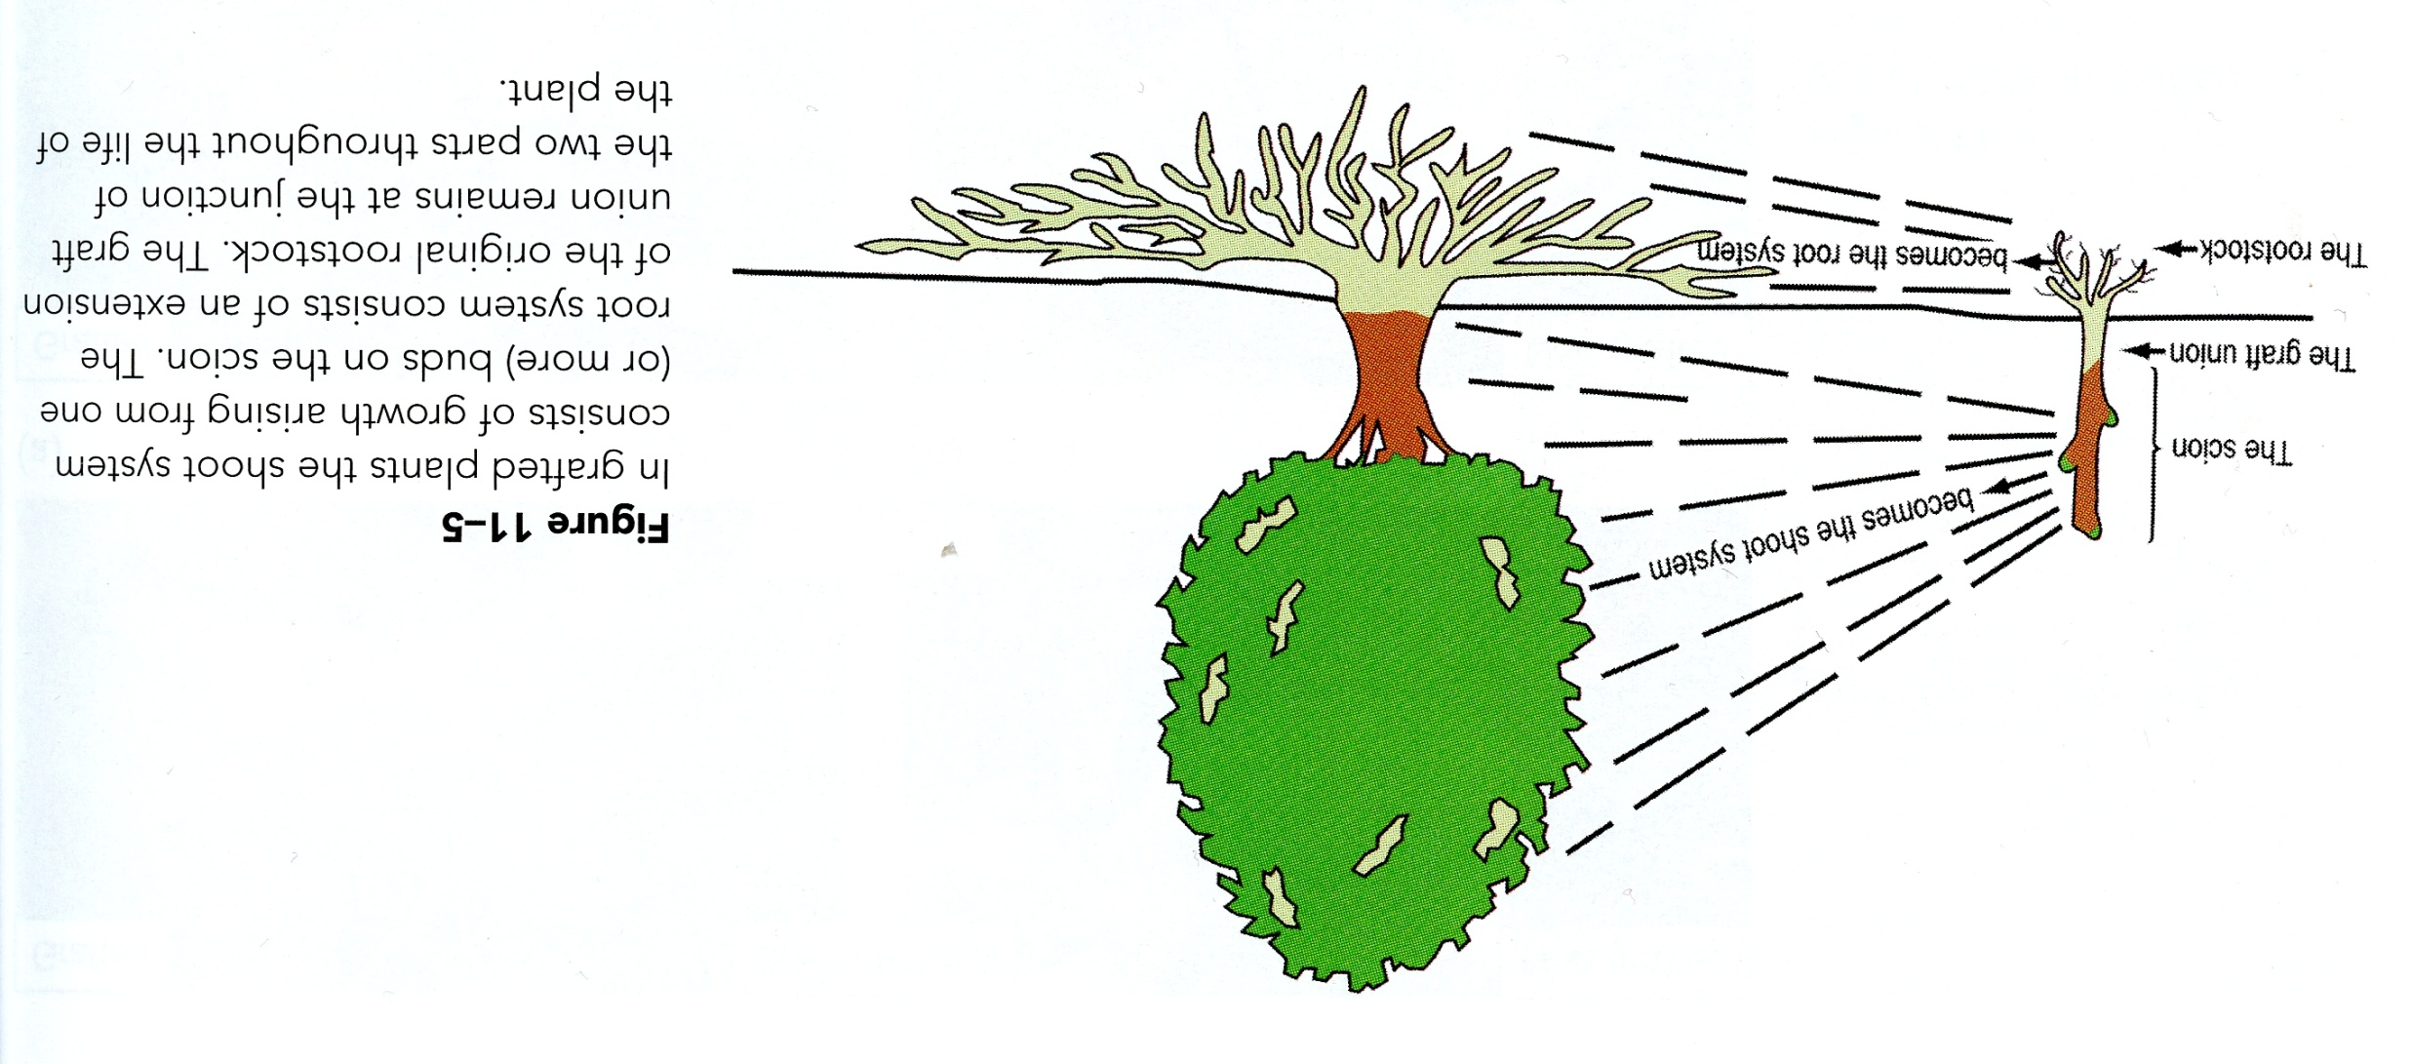
Grafting

Slide 4
Reasons For Grafting

Slide 5
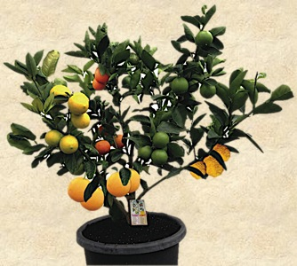
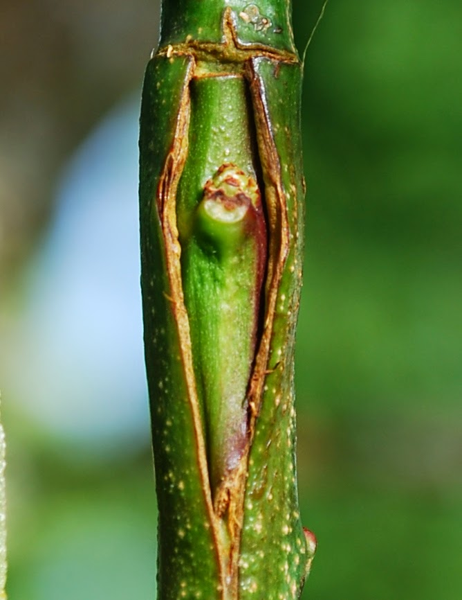
Can’t be reproduced by any other asexual means
https://www.pinterest.com/selvielango/grafting/
http://growinggreener.blogspot.ca/2014_06_01_archive.html

Slide 6
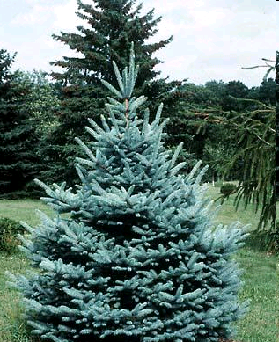
To change the size of the resulting Plant
http://www.thetreefarm.com/spruce-blue-sester-dwarf

Slide 7
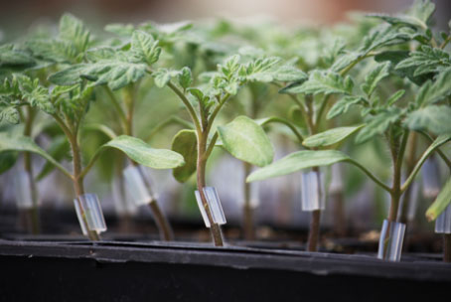
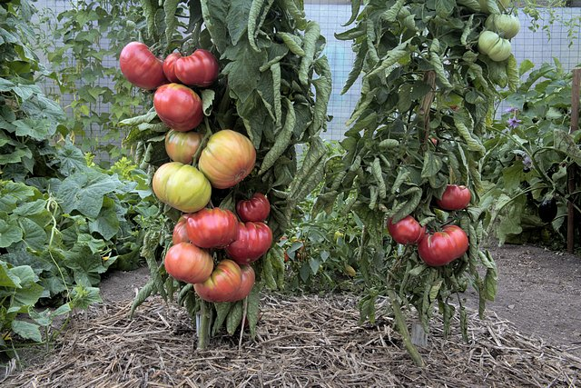
Produce Disease Resistance
http://www.goodharvestfarms.com/
http://blogs.vancouversun.com/2012/05/04/heres-the-hottest-thing-in-tomatoes-this-year/

Slide 8
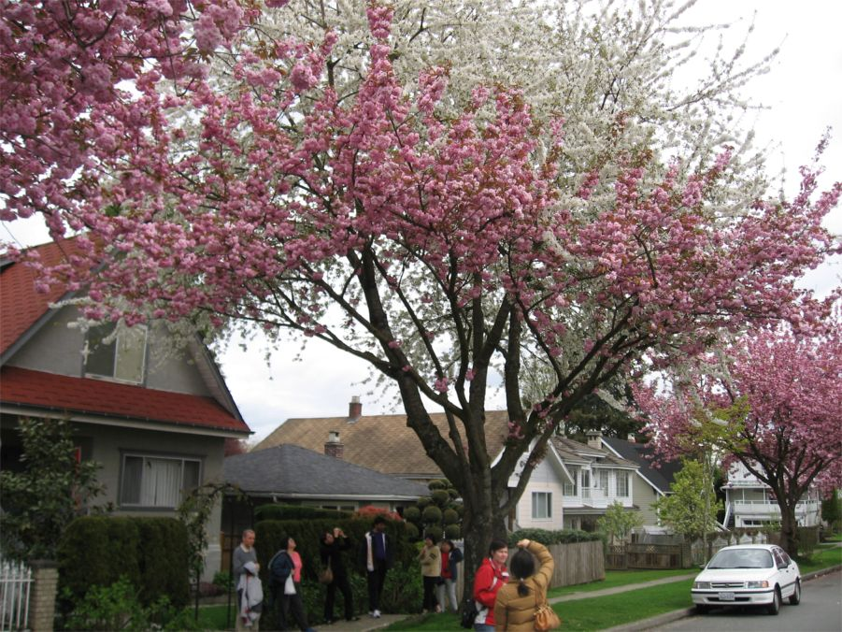
Provide a suitable pollinator variety - ‘Topworked’ plant
https://vcbfblog.wordpress.com/tag/grafted-cherry-tree/

Slide 9
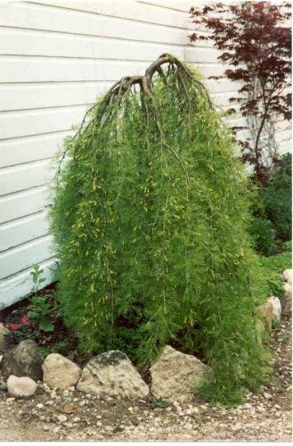
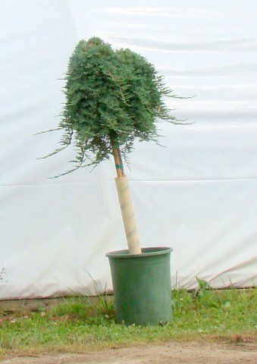
To change the form of a resulting plant
http://www.richsfoxwillowpines.com/catalog/?category=1&product=338
http://www.blueviewnurseries.com/topiary.html

Slide 10
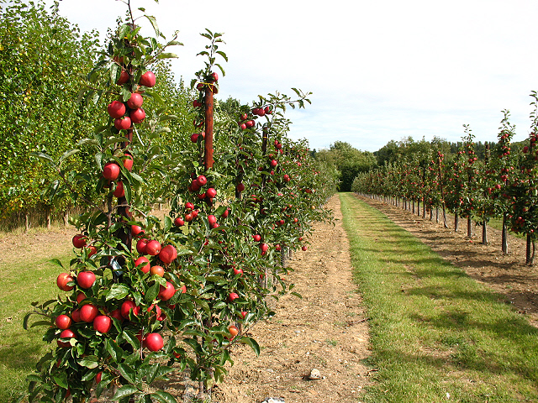
To produce earlier flowering or fruiting
http://www.geograph.org.uk/photo/1476095

Slide 11
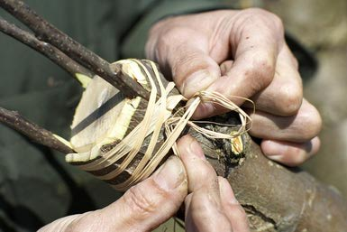
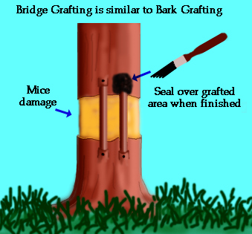
To repair damaged plants
http://treesandshrubs.about.com/od/pruning/a/repair-broken-trees.htm
http://www.appleman.ca/korchard/bridgrft.htm

Slide 12
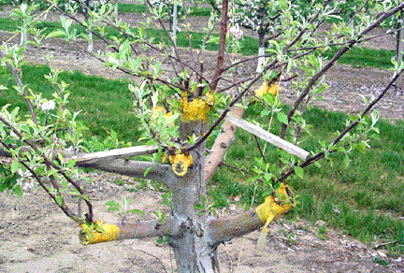
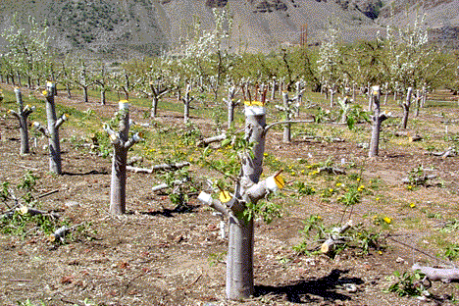
To change the variety of the resulting plant
http://county.wsu.edu/chelan-douglas/agriculture/treefruit/Pages/Bark_Grafting.aspx

Slide 13
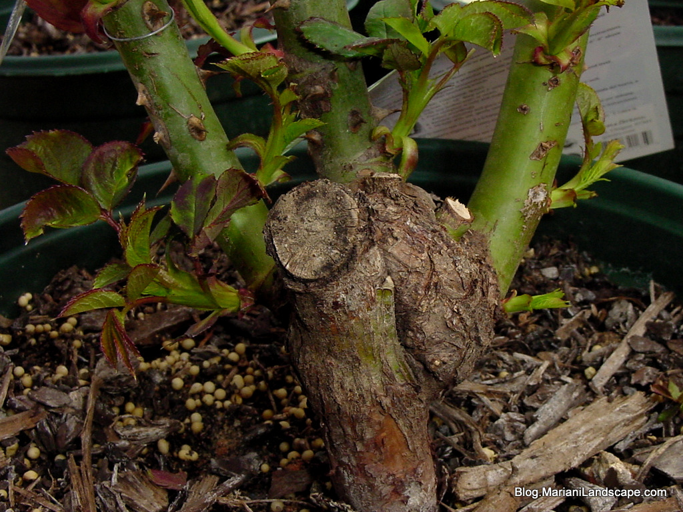
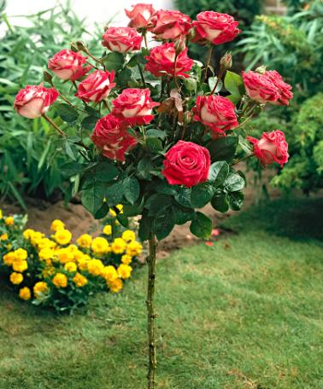
To create plants tolerant to environmental conditions
http://plantanswers.com/grandmas_yellow_rose07.htm
http://www.bakker-holland.hu/termek/torzses-rozsa-nostalgie-/

Slide 14
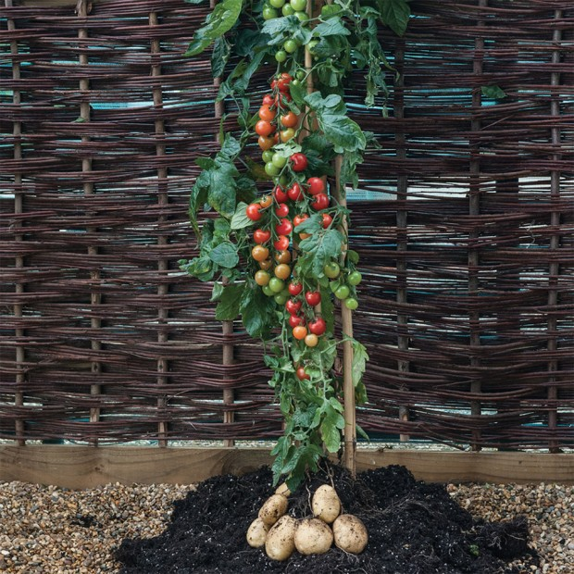
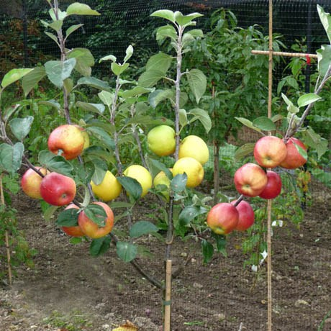
To create something new
Pomato
Fruit Salad
https://www.pinterest.com/pin/417216352954299158/
https://prospectrockpermaculture.wordpress.com/tag/cross-pollination/

Slide 15
Graft Compatibility
Relationship Grafting Success
Within a species Excellent
Two species within genus Good
Two genera within a family Possible
Two families within an order Very rare

Slide 16
Requirements For Success
Stock and scion must be compatible
Rootstock diameter grater or close to the scion diameter
Cambial regions of stock and scion must be intimate
Stock and scion in proper physiological stage
Waterproof graft junction
Timing of graft
Proper care until graft unites

Slide 17
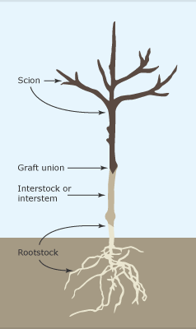
Interstock
A second stock placed between the scion and rootstock
Used to reduces scion vigor
Used to make dwarf apple trees on a stable rootstock that does not require staking
Used when a rootstock and scion are incompatible
http://sitesystems-landscape.com/blog/two-is-company-threes-a-crowd/

Slide 18
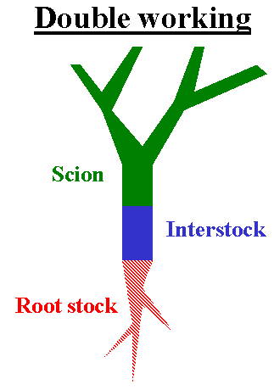
Scion (Cultivar of choice
Interstock (M9 dwarf)
Rootstock M2 (give a medium size vigorous tree)
Though the scion and rootstock are incompatible they are both compatible with the interstock

Slide 19
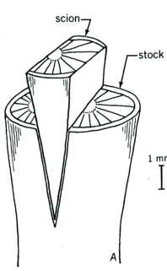
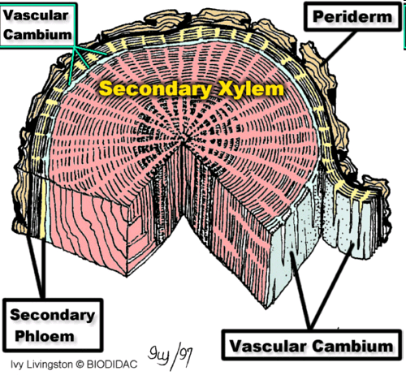
The Graft Union

Slide 20
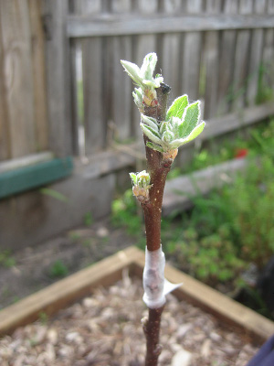
Graft Union Environment
Temperature is kept at 20-25 ºC
Humidity inside the tissue should be at 100% to ensure new parenchyma cells stay turgid. Achieved by waxing the graft union or placing grafted plants in a tent under cover
Oxygen is required by the healing process
Secure hold is achieved with a rubber band, grafting tape, or electric tape
http://www.waldeneffect.org/blog/Two_grafts_for_beginners/

Slide 21
Callus Formation
What is Callus?
A mass of parenchyma cells that develop from and around wounded plant tissue at the graft union
Originate from both the scion and rootstock
The cell masses interlock and fill spaces 1-7 days after grafting

Slide 22
Parenchyma

Slide 23
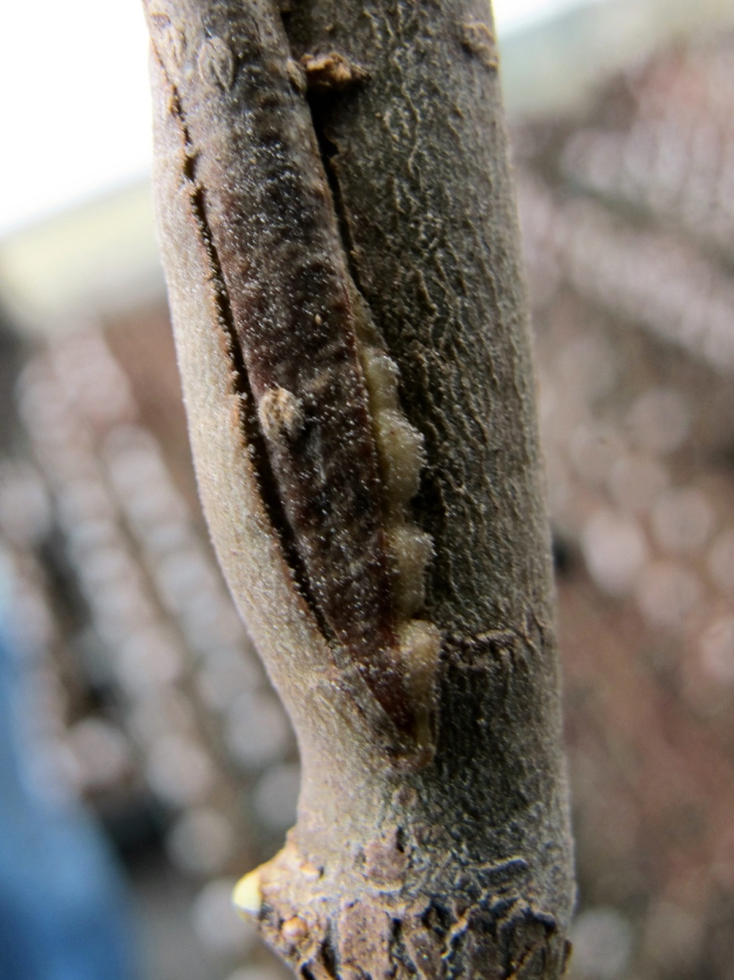
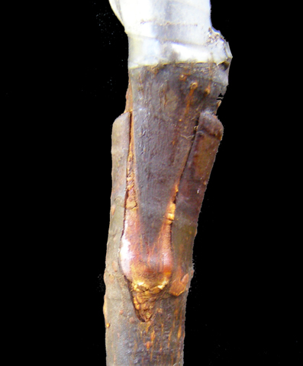
Callus Formation
https://www.flickr.com/photos/kpaulus/8517455784/
http://figs4fun.com/More_Info_Grafting.html

Slide 24
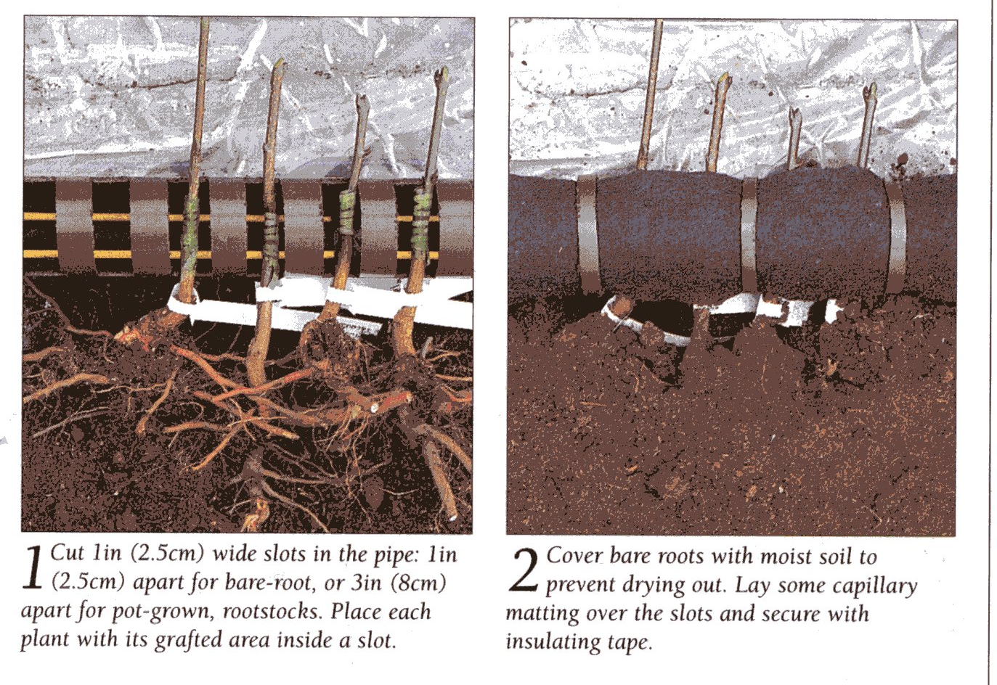
Hot Pipe Callusing

Slide 25
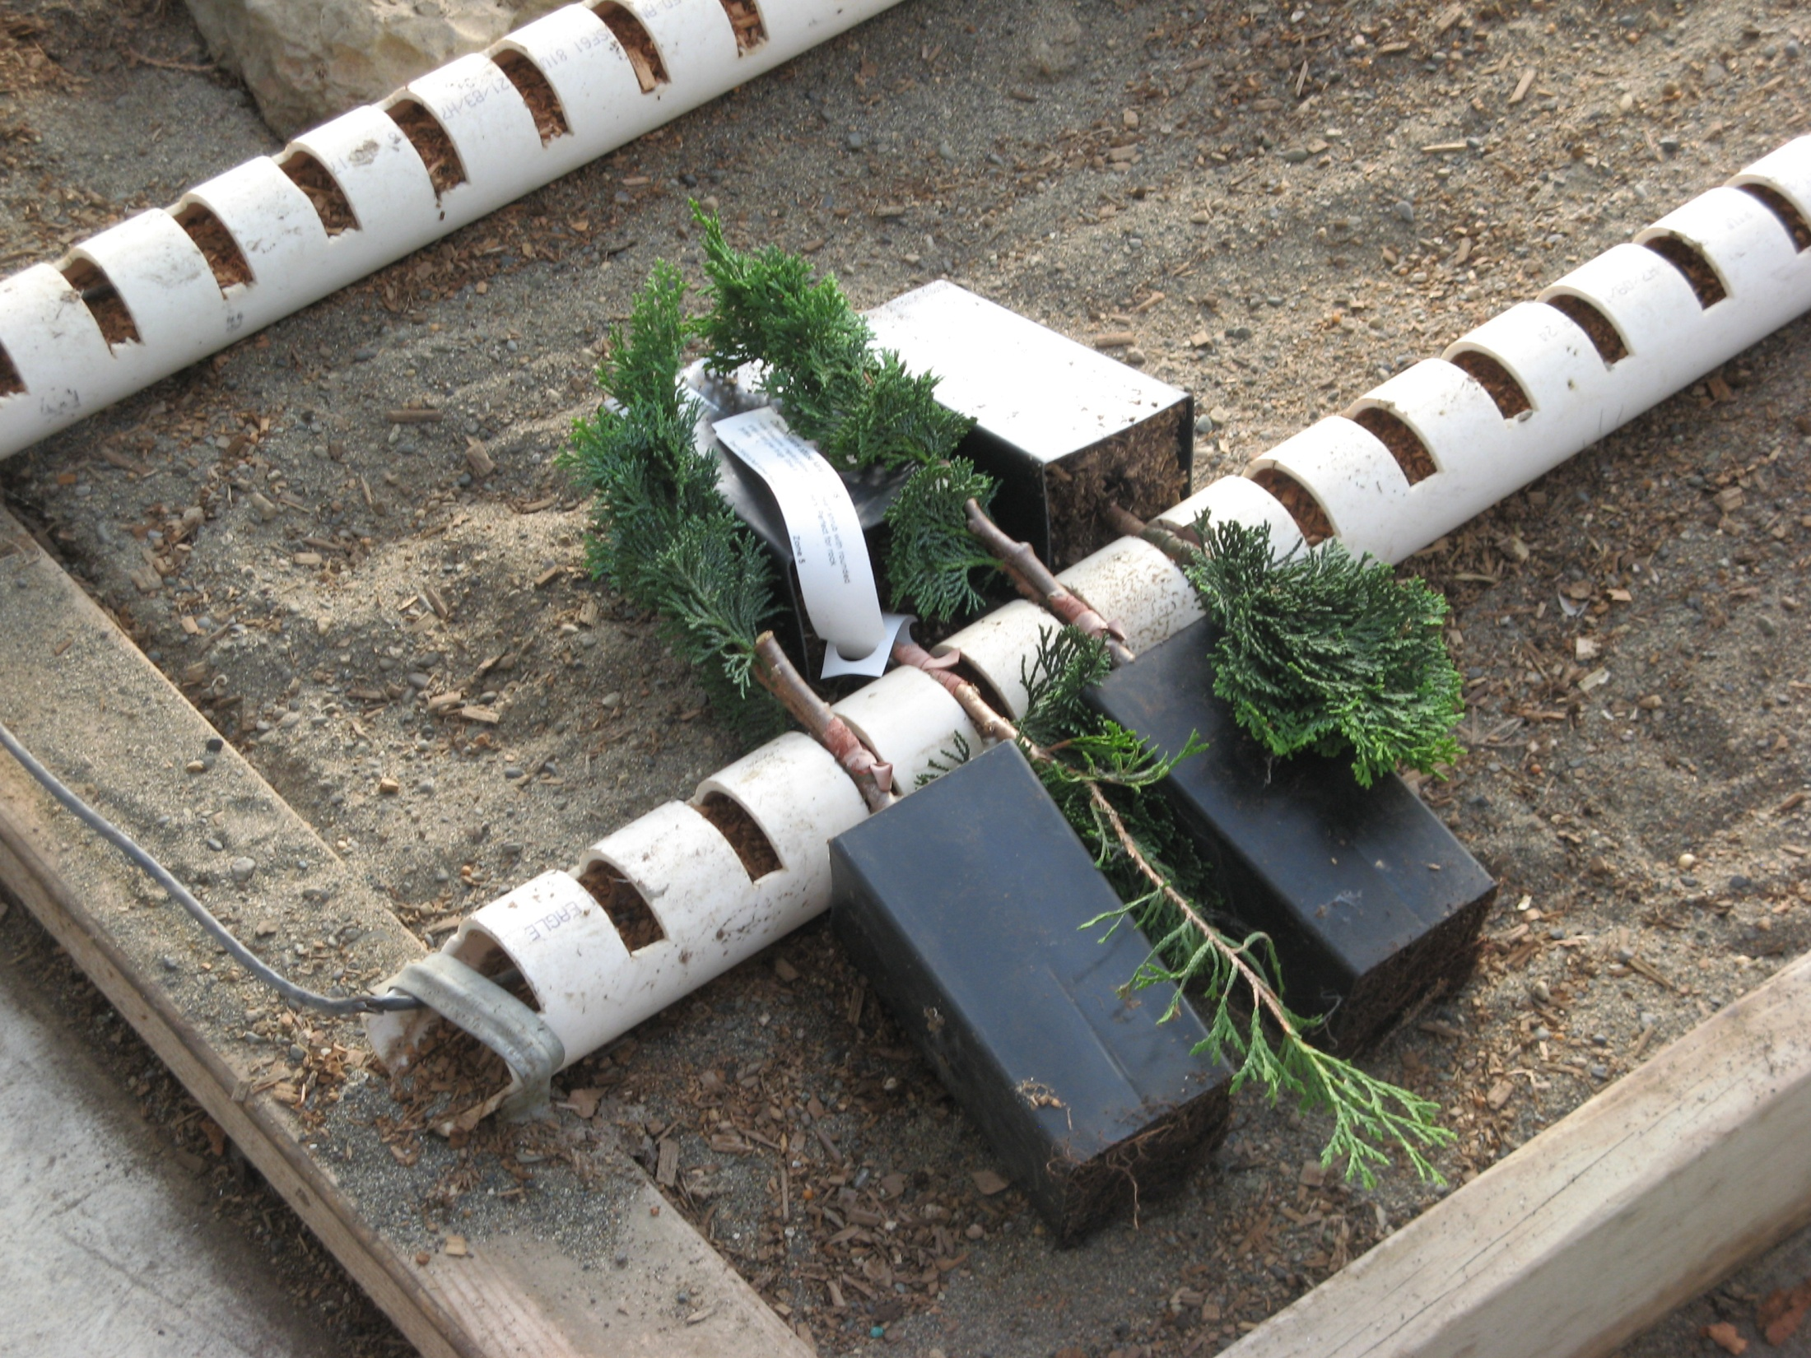
Yellow Cedar need to be placed in the hot callusing pipes as they are more difficult to callus
Pacific Northwest Propagator

Slide 26
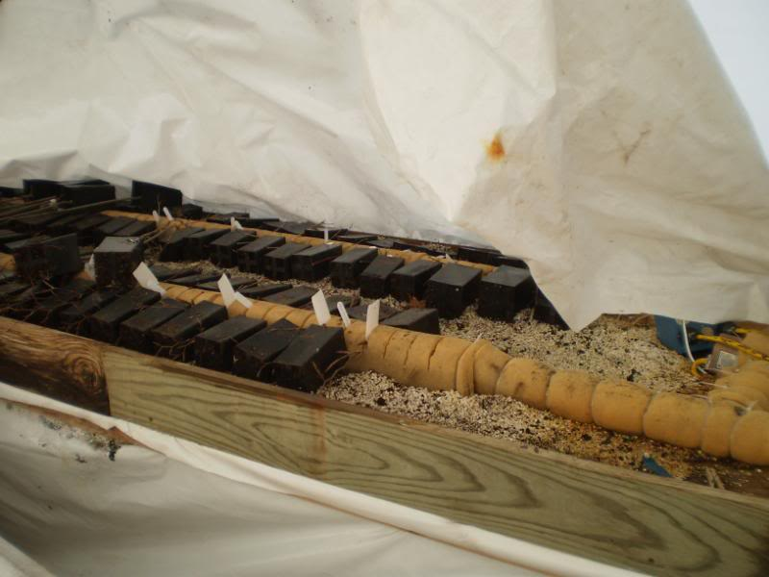
http://forums.gardenweb.com/forums/load/conif/msg0209435816554.html?17

Slide 27
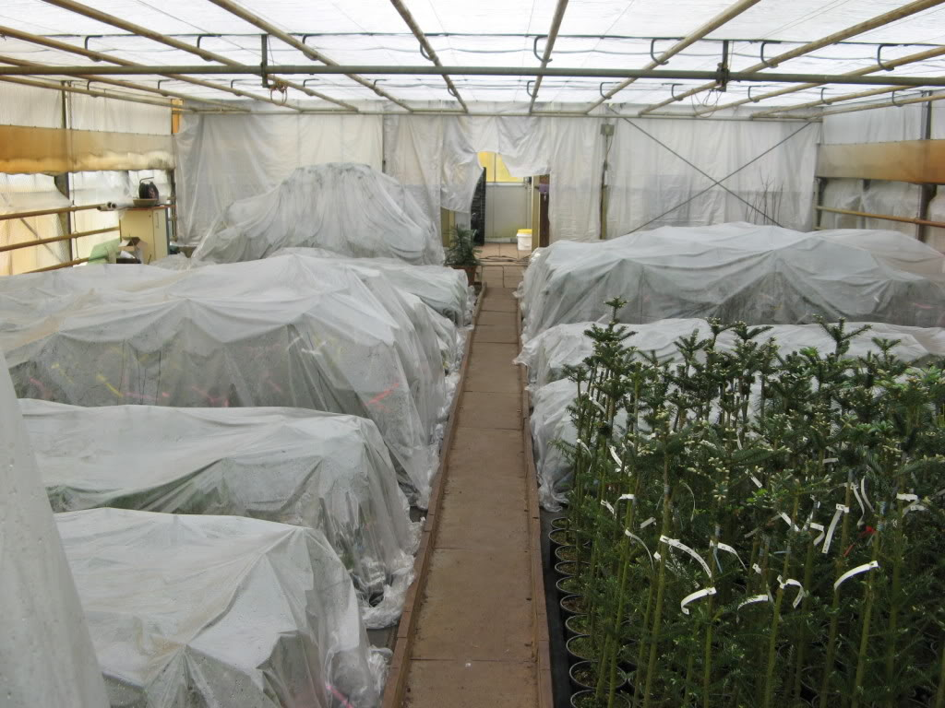
Healing the Grafts in a Humid Environment
http://forums.gardenweb.com/forums/load/conif/msg0209435816554.html?17

Slide 28
Cambium formation
Selected cells of newly formed callus bridge between layers of intact scion and rootstock and differentiate into new cambium cells
Occurs 2-3 weeks after the graft is made
New cambial cells produce new xylem and phloem

Slide 29
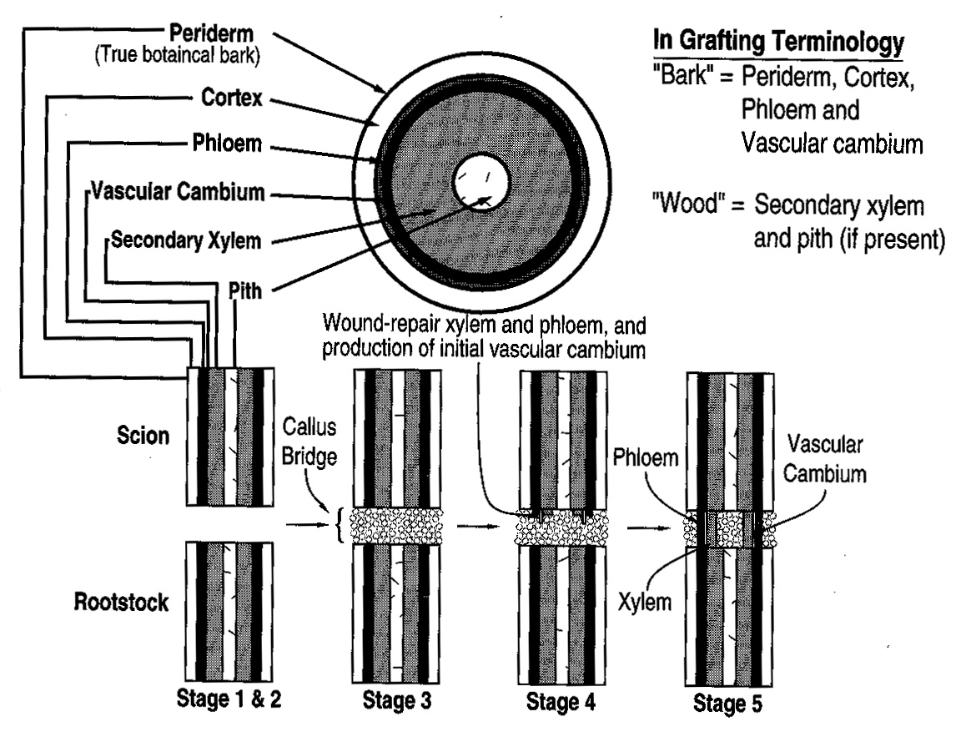
Formation of the Graft Union
Lining up cambiums
Wound response
Callus bridge formation
Cambium formation
Vascular tissue formation

Slide 30
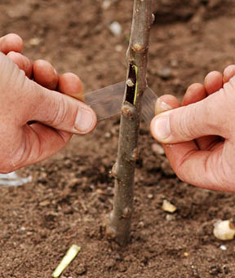
Budding Healing Process
Bud shield is inserted
Necrotic plate of material develops from cut cells
Callus parenchyma cells break through the necrotic plate surrounding the bud shield filling all air pockets
A continuous cambium is established between the bud and the rootstock

Slide 31
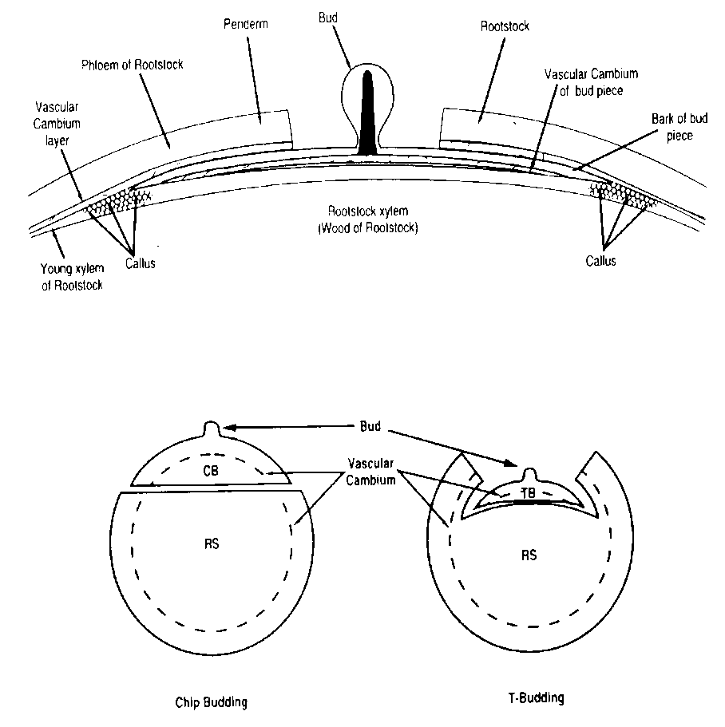
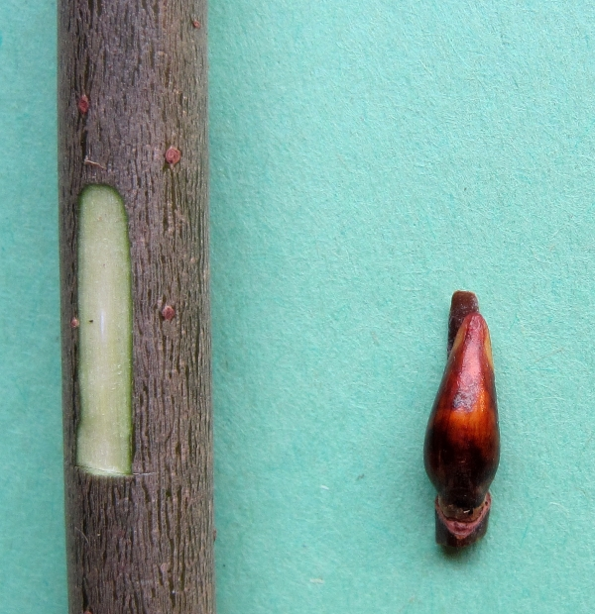
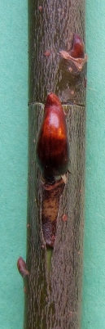
Budding Healing Process
Chip Bud
T - Bud
T-bud shown above & below, right
Chip bud shown below, left

Slide 32
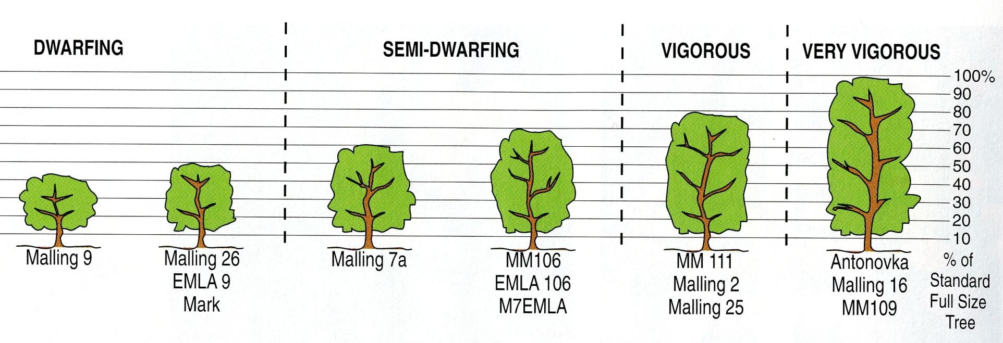
Dwarfing Rootstocks

Slide 33
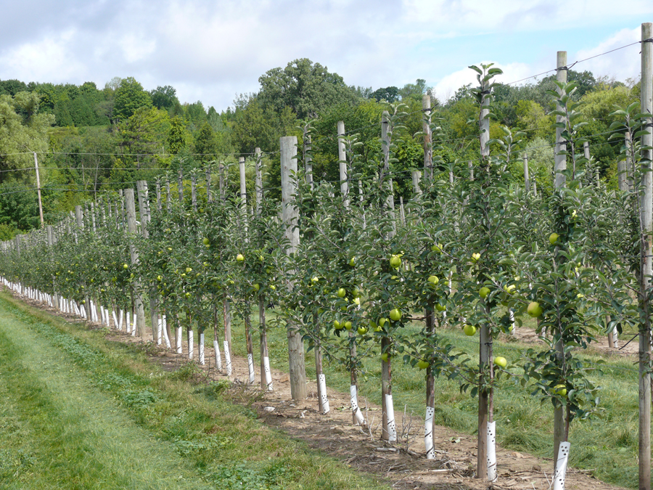
High Intensity Apple Orchards

Slide 34
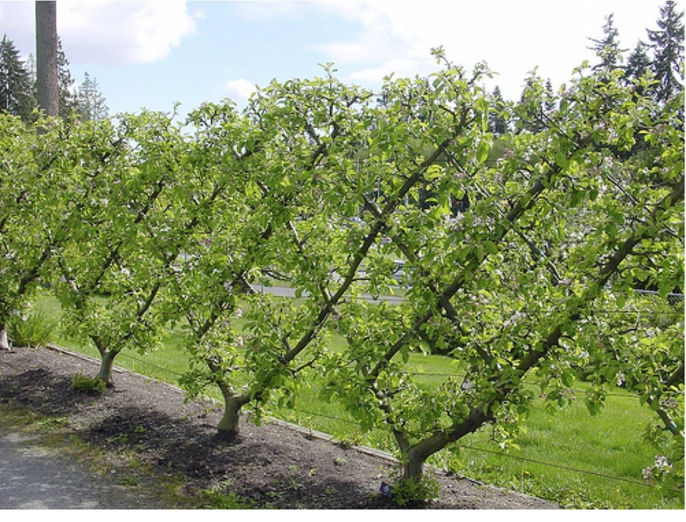
Espalier Apple Trees

Slide 35
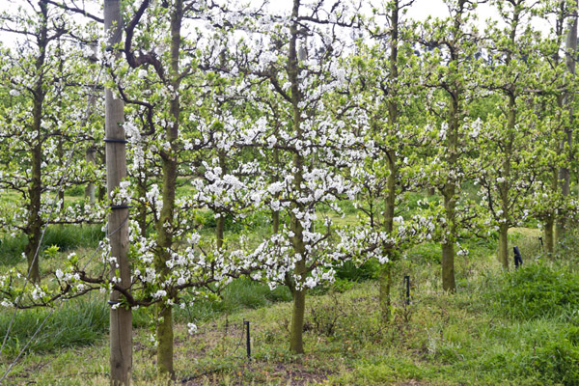
http://www.thegardeningblog.co.za/gardening/apple-espalier/

Slide 36
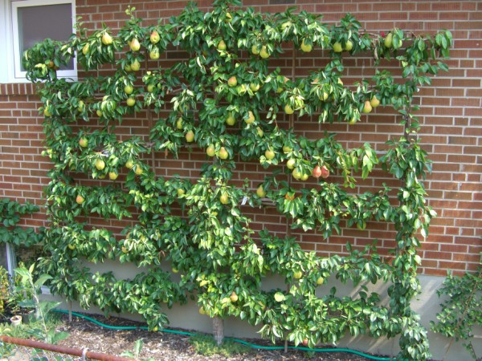
Espalier Pear Tree
http://www.magicherbgarden.com/2011/01/espalier-beautiful-trees-small-space/

Slide 37
Reasons For Failure of a Graft
An overactive rootstock resulting in bleeding
Presence of a virus, insect or disease
Poor matching of cambium
Drying out of the graft union
Desiccated scions
Scion was placed upside down (polarity)
Incompatibility

Slide 38
Symptoms of Graft Failure
High failure rate at the graft union
Yellowing of foliage in the latter part of the growing season
Death in a year or two after grafting
Overgrowth above and below the graft union
Excessive suckering of rootstock
Graft components breaking apart

Slide 39
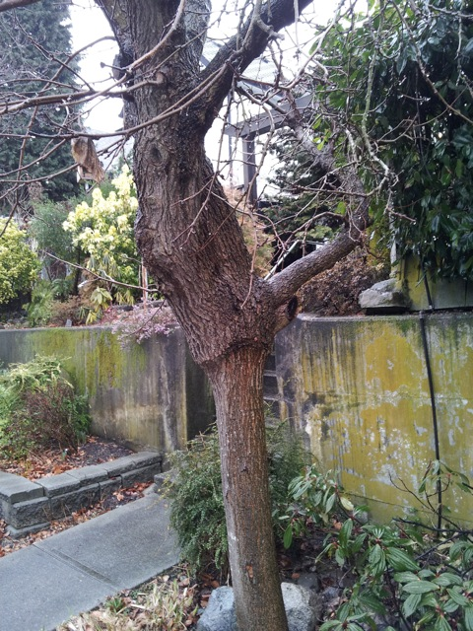
Poorly matched scion an rootstock
Scion
Graft Union
Root stock

Slide 40
Questions?!!

